Slide 1
Introduction to Machine Learning

Slide 2
What is Machine Learning
Machine learning: "Field of study that gives computers the ability to learn without being explicitly programmed“
Well posed learning problem: "A computer program is said to learn from experience E with respect to some class of tasks T and performance measure P, if its performance at tasks in T, as measured by P, improves with experience E."

Slide 3
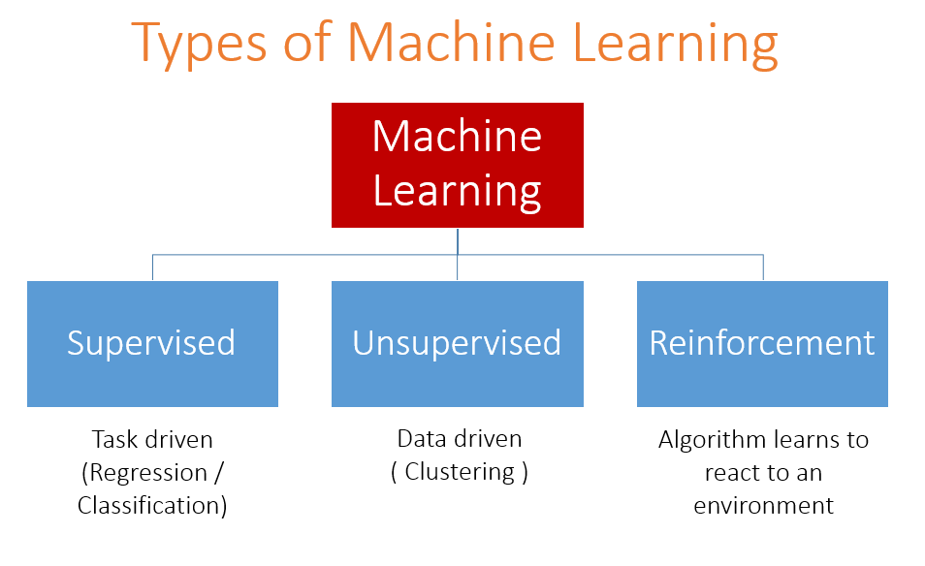

Slide 4
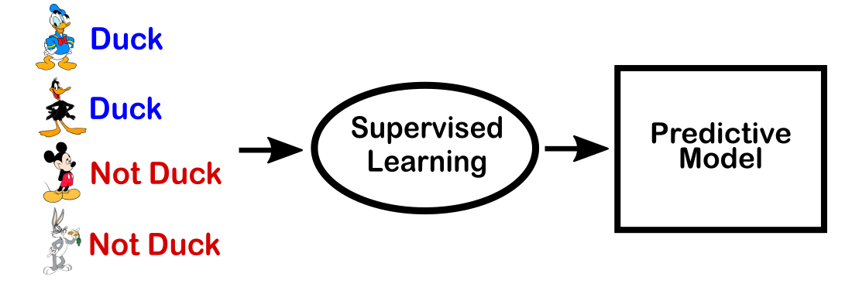
Supervised Learning

Slide 5
Supervised Learning Applications
Prediction of future cases: Use the rule to predict the output for future inputs
Knowledge extraction: The rule is easy to understand
Compression: The rule is simpler than the data it explains
Outlier detection: Exceptions that are not covered by the rule, e.g., fraud

Slide 6
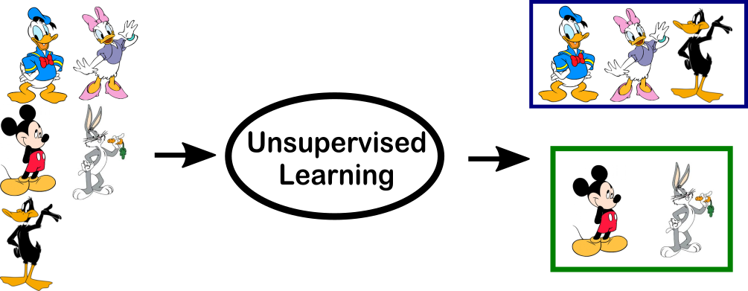
Unsupervised Learning

Slide 7
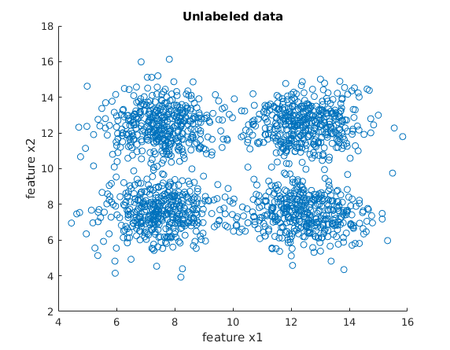
Unsupervised Learning

Slide 8
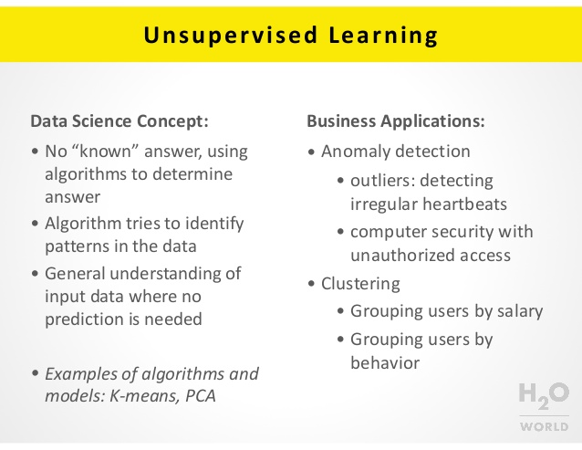
Unsupervised Learning Applications

Slide 9
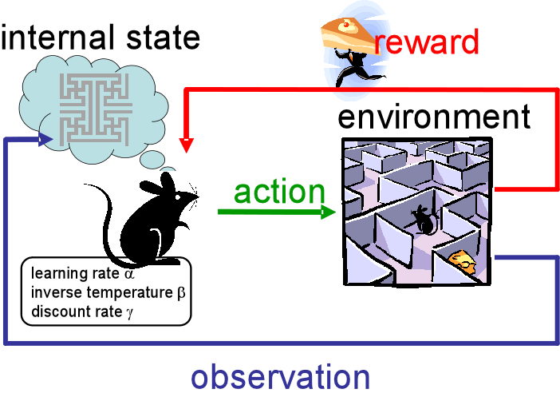
Reinforcement Learning

Slide 10
Reinforcement Learning Applications
Topics:
Policies: what actions should an agent take in a particular situation
Utility estimation: how good is a state (→used by policy)
No supervised output but delayed reward
Credit assignment problem (what was responsible for the outcome)
Applications:
Game playing
Robot in a maze
Multiple agents, partial observability, ...

Slide 11
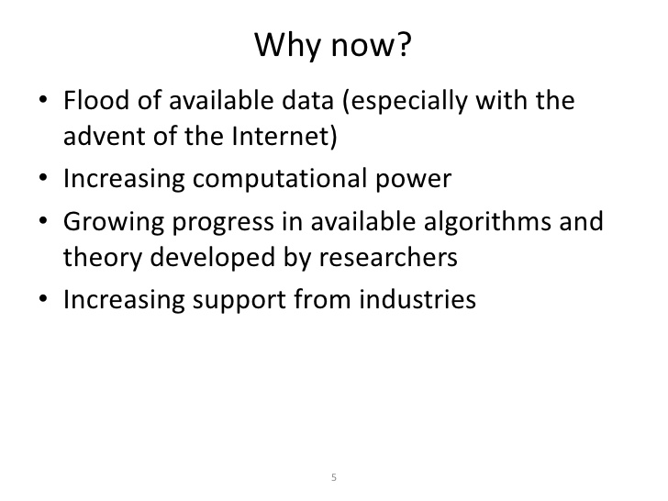

Slide 12
Thank you

